Slide 1

Lecture: 7
Profit and Loss

Slide 2
Contains:
1. Concept of Cost price, selling price and marked price.
2. Calculation of Profit Loss percentage.
3. Common Selling Prices

Slide 3
Concept of Cost price, Selling price and Marked price
Cost Price: The price, at which an article is purchased, is called its cost price, abbreviated as C.P.
Selling Price: The price, at which an article is sold, is called its selling price, abbreviated as S.P.
Profit or Gain: If S.P. is greater than C.P., the seller is said to have a profit or gain.
Loss: If S.P. is less than C.P., then the seller is said to have incurred a loss.

Slide 4
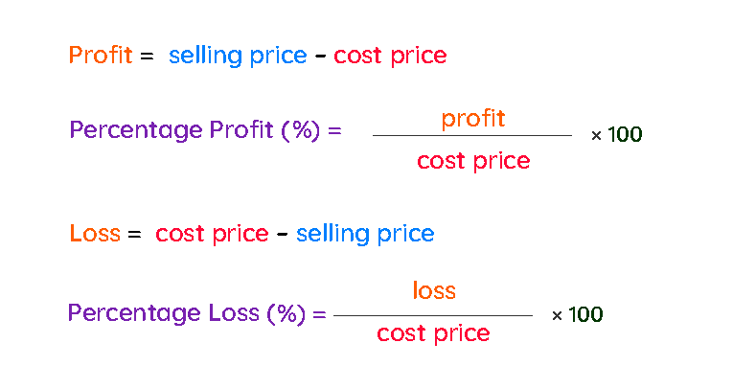

Slide 5
MP= Rs. 600
Discount =Rs.100
Mark up= Rs. 200
SP= Rs.500
Profit
= Rs.100
CP= Rs.400
A shopkeeper buys a T-shirt from wholesale market at Rs.400 and marked that article Rs.200 above the CP. After giving a discount of Rs.100 he sold it at Rs.500.

Slide 6
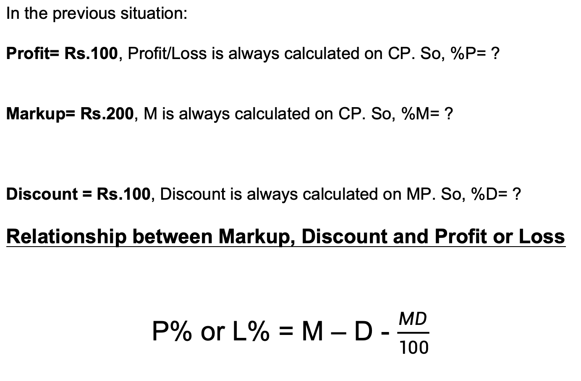

Slide 7
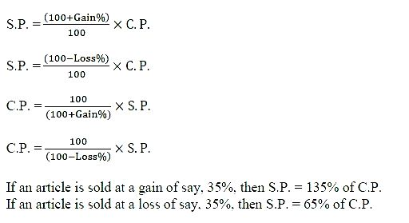

Slide 8
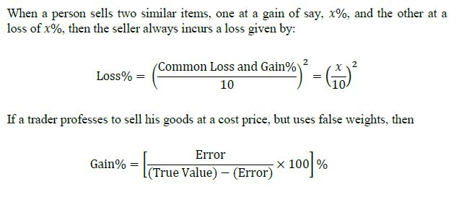

Slide 9
Calculation of Profit loss percentage

Slide 10
Questions: A TV is purchased at Rs. 5000 and sold at Rs. 4000, find the lost percent.
[A] 10%
[B] 20%
[C] 25%
[D] 28%

Slide 11
Question: CP = Rs.500
P = 20 %
SP = ?
Question: CP = Rs.800
L = 30 %
SP = ?

Slide 12
Question: SP = Rs.720
P = 20 %
CP = ?
Question: SP = Rs. 810
L = 10 %
CP = ?

Slide 13
Questions: When a plot is sold for Rs. 18,700, the owner loses 15%. At what price must that plot be sold in order to gain 15%?
[A] Rs.21000
[B] Rs.22500
[C] Rs.25300
[D] Rs.25800

Slide 14
Questions: Alfred buys an old scooter for Rs. 4700 and spends Rs. 800 on its repairs. If he sells the scooter for Rs. 5800, his gain percent is
[A] 6/19%
[B] 6/11%
[C] 60/11%
[D] 38/11%

Slide 15
Question: A shopkeeper selling his goods at 20% profit. Had he purchase it 10% less and sold it for Rs.18 less then he would get 30% profit. Find the initial CP of that article.
[A] 540
[B] 600
[C] 1200
[D] 720

Slide 16
Question: A shopkeeper selling his goods at 10% profit. Had he purchase it 20% less and sold it for Rs.20 more then he would get 40% profit. Find the initial SP of that article.
[A] 1000
[B] 2000
[C] 1100
[D] 720

Slide 17
Question: A shopkeeper sold an article at 25% profit. If the CP and SP are decreased by Rs.20 and Rs.40 respectively then the profit percent would be decreased by 15 %. Find CP of the articles.
[A] 120
[B] 200
[C] 180
[D] 240

Slide 18
Question: A shopkeeper purchase 2 articles for Rs.9600. He sold the first article at 20% loss and second article at 60% profit then he find that both the articles being sold on the same price. Find the CP of first article.
[A] 6400
[B] 3200
[C] 6000
[D] 5400

Slide 19
Question: A shopkeeper sells 2 articles. He sold the first article at 15% loss and second article at 19% profit. During the whole transaction he earn a loss of Rs90. Find the CP of second article if the SP of both articles are same.
[A] 5000
[B] 4500
[C] 2000
[D] None

Slide 20
Question: A shopkeeper sells 3 articles. He sold the first article at 20% profit, second article at 10% loss and third at 25% loss. During the whole transaction he earn a loss of Rs60. Find the SP of first article if the SP of all the articles are same.
[A] 216
[B] 180
[C] 240
[D] None

Slide 21
Questions: A sold a table to B at a profit of 15%. Later on, B sold it back to A at a profit of 20%, thereby gaining Rs. 69. How much did A pay for the table originally?
[A] Rs.300
[B] Rs.320
[C] Rs.345
[D] Rs.350

Slide 22
Common Selling Price

Slide 23
Q. A man sold 2 bicycles at the same selling price. One at 20% loss and other at 20% profit. Find overall profit and loss percentage.
4% loss
5% loss
2% profit
8% loss

Slide 24
Q. Amit sold 2 laptops at the same selling price. One at 10% loss and other at 20% profit. Find overall profit and loss percentage.
20/7% profit
50/11% profit
20/9% loss
none of these

Slide 25


